Slide 1


rakirahman.me
Hi, I’m Raki.
I build Big Data & AI Solutions on Microsoft Azure.

Slide 2


rakirahman.me
Hey look,
IT’S A BLOG!

Slide 3




rakirahman.me
BLOGGING WITH
on Azure

Slide 4
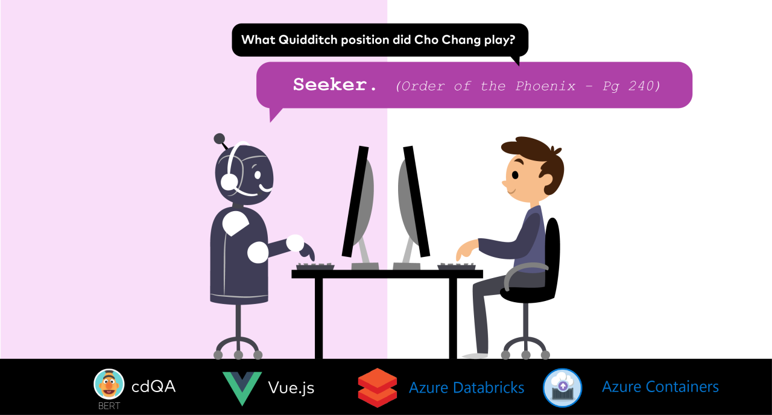
rakirahman.me

Slide 5




rakirahman.me
PART 1
COMPREHENSIVE
STUDY GUIDE

Slide 6
rakirahman.me
PART 2
COMPREHENSIVE
STUDY GUIDE

Slide 7

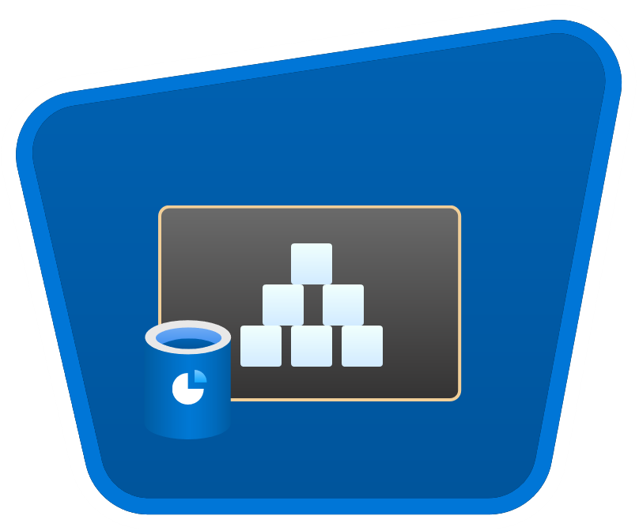




rakirahman.me
AUTOMATING
to Synapse
with Autoloader

Slide 8

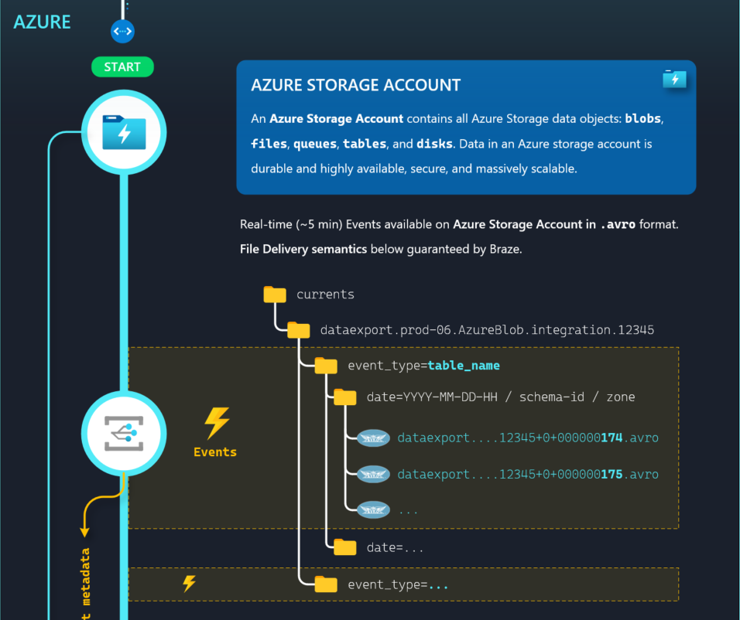
ILLUSTRATION
to Synapse
with Autoloader

Slide 9
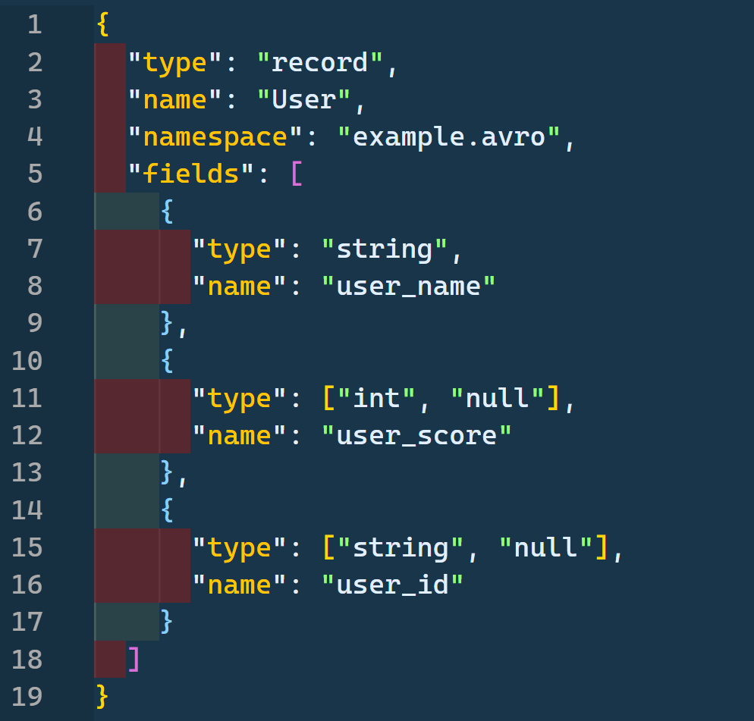

Exploring Azure Schema Registry with

Slide 10


rakirahman.me
PACKING
DENSITY
PREMIUM
MAXIMIZING
App Service Plan
AZURE FUNCTIONS

Slide 11
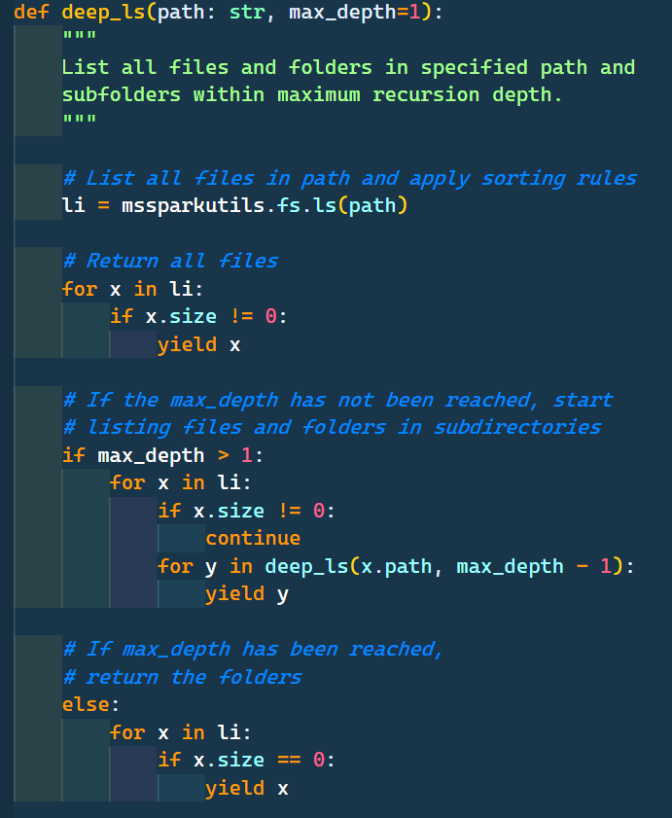



Slide 12
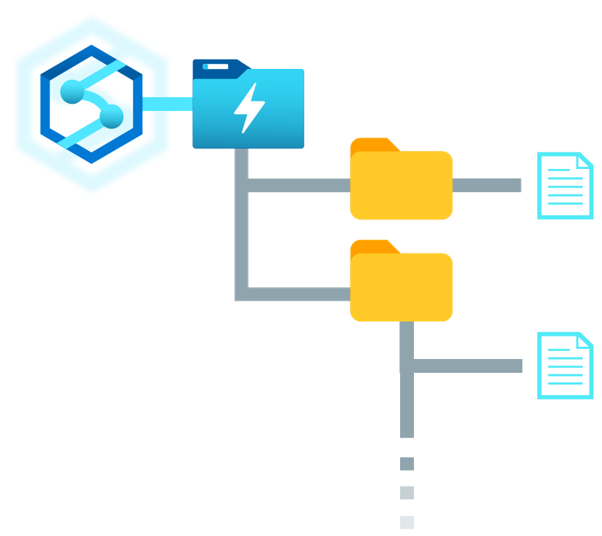
How to Recurse through Data Lake Folders with
Synapse Spark Pools

Slide 13


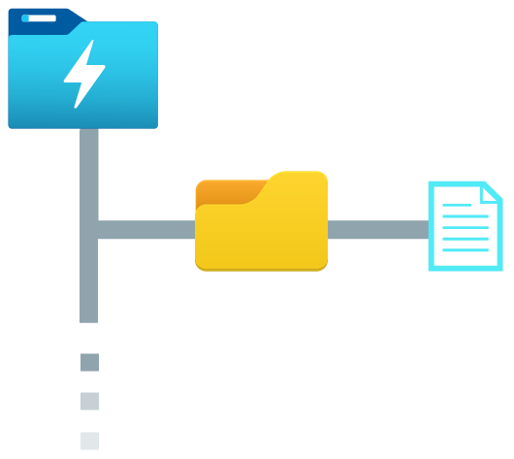



Purview
Synapse
Column name
Classifications
filename
asset
schema
email
Email Address
CashFlow_01.csv
CashFlow_{N}.csv
0: email, PERSONAL.EMAIL
1: creditcard, FINANCIAL.CREDIT_C...
2: creditcardtype, NULL
3: amount, NULL
creditcard
Credit Card Number
REST API
CashFlow_01.csv
creditcardtype
amount
Sales_02.parquet
Sales_{N}.parquet
[["ip_address","PERSONAL.IPADDRES...
CashFlow_{N}.csv
Profit_01.json
Profit _{N}.json
"[["id",null],["IBAN",“FINANCIAL...
Spark DataFrame
Exploring Purview’s API: accessing asset classifications in Synapse

Slide 14
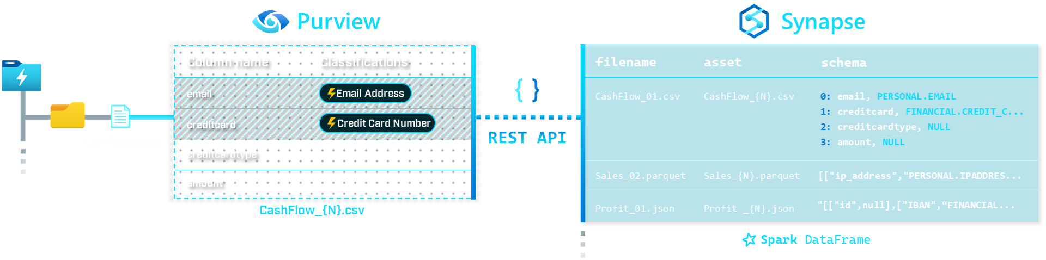
Exploring Purview’s API: accessing asset classifications in Synapse

